Slide 1
REGIONAL DELIVERY PLAN 2021/22

Slide 2
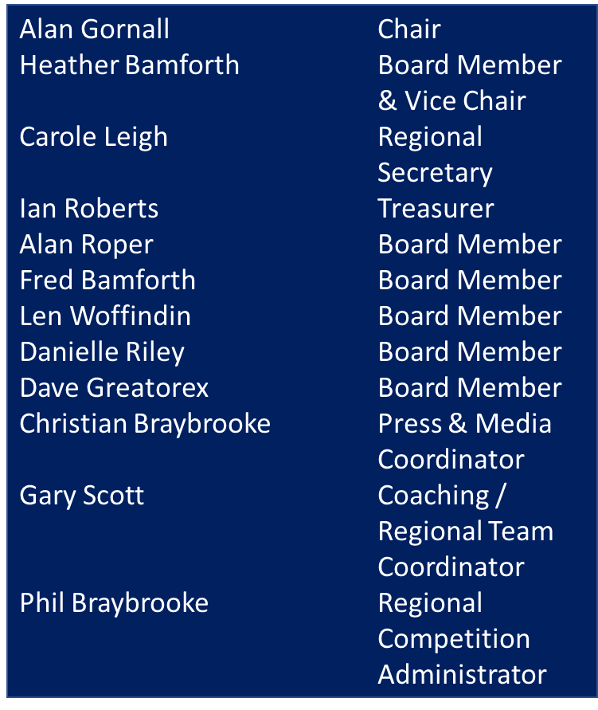
NW REGIONAL BOARD
NW Regional Board Work Groups
Road Fred Bamforth
Track TBC – new for 2021
Mountain Bike Len Woffindin
Cyclocross Len Woffindin
Regional Delivery Plan Heather Bamforth
& Finance
Membership & Danielle Riley
Recreation
Diversity & Inclusion Heather Bamforth
Event Support Group Phil Braybrooke
Coaching & Youth Gary Scott
NW Regional Academy Heather Bamforth

Slide 3
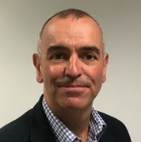
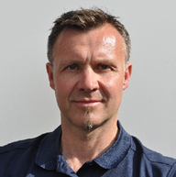
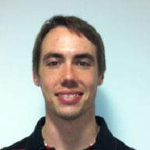
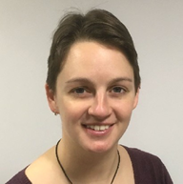
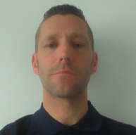
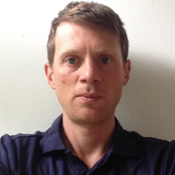
NW REGION
Rob Pickering
Lead Cycling Delivery
Manager
John Wych
Clubs & Coaching Officer
Adam Newall
Regional Events
Officer
Beth Barrett
Community Activator
Manchester
Craig Ansell
Go-Ride Coach
Simon Wilson
Go-Ride Coach
Rob Hawker
Go-Ride Coach - GLL

Slide 4
OUR OBJECTIVES
GEARS FOR GROWTH
GEAR 1 | PATHWAYS: Grow and sustain the participation base, widen access and develop progressive pathways for more people to cycle more often
GEAR 2 | PIPELINE: Develop a seamless and accessible talent pathway providing opportunities for riders to be the best they can be
GEAR 3 | PEOPLE: Grow, support and nurture the cycling workforce (paid and unpaid)
GEAR 4 | PLACES: Develop and grow the network of safe and accessible cycling facilities
GEAR 5 | PARTNERSHIPS: Secure and grow partnerships with a range of partners such as regional boards, core cities, local authorities and HSBC UK
The Gears for Growth will be underpinned by the foundations below, these will be front of mind when developing and implementing the plans:
LEADERSHIP – Provide insight and leadership in the region, supporting the regional team and board to represent the needs of cycling through effective ways of working
DIVERSITY &INCLUSION – Cycling should be accessible for everyone regardless of background or circumstance and we will strive to improve access through our work in the regions
PROFILE – Grow the profile and reach of the regions work through improved communication and promotion

Slide 5
PRIORITIES FOR 2021/22
Pathways
Cycle Sport
Rebuild a balanced, coordinated, flexible, competitive cycling calendar across all disciplines with a strong geographical spread that is supported by an appropriate volunteer workforce and meets the key themes of the Discipline Plans.
Ensure that effective pathways exist from recreational rides through clubs and Talent Development Centres (TDC) so that we are continually growing participation in the sport and maximising elite success.
Clubs and Children & Young People
Maximise the output of the NW Go Ride coaches in Manchester and Tameside schools and communities, driving-up young people’s participation in Ready Set Ride, Go Ride competition and Go-Ride Racing whilst providing effective signposting and access to pathways.
Through effective club engagement and affiliation, maximise clubs and groups participation opportunities.
Recreation
Broaden the reach of and increase participation in recreational ride programmes across the NW region and particularly where Community Activator resource is present in GM. Deliver Let’s Ride Manchester 2021. Seek opportunities to encourage more cyclist to become British Cycling members.
Develop the Ride Leader / Breeze Champion volunteer base and route / ride availability to deliver more rides and increased participation (particularly at entry level).
Pipeline
Continue to develop TDCs across the region (Greater Manchester (GM) / Lancashire) – Road, Mountain Bike, Track and identify a team of female coaches that can link into TDCs and act as ambassadors for women and girls coaching across the region.
Identify opportunities to expand cycling development and racing chances for people from ethnically diverse communities and the LGBTQ+ communities.
People
Implement a regional training plan and Continuous Professional Development (CPD) process for both paid and volunteer staff using all available resources and technologies.
Re-engage with ‘dormant’ / ‘latent’ coaches and identify appropriate coaching opportunities for them to ensure they are retained and active within the sport.
Partnerships
Existing Partners
Work closely with our local authority partners in Manchester, Tameside and Lancashire to increase participation in cycle sport and recreation and seek opportunities to develop British Cycling business in other NW local authority areas.
Work with a range of landowners (National Trust, Canal & Rivers Trust, Forestry England, Wildlife Trust and the private sector) to develop cycle sport and recreational cycling across the NW.
Future Partnership Opportunities
Pursue a place-based approach with Sport England Local Delivery Pilot areas to identify a new way of supporting and delivering cycling activity in Blackburn with Darwen, Hyndburn, Oldham, Manchester, Liverpool.
Develop new partnership opportunities with Wirral, Carlisle, Cheshire West, Access Sport (GM) and progress to full partnership status.
NW Regional Board
Fully establish the new NW Regional Board structure including workgroups for Membership & Recreation and Diversity & Inclusion and support the Board in implementing the good governance review and increasing its visibility.
Support the Introduction of the NW Regional Academy and implement across the NW region giving young talented riders the opportunity to develop both in and out of the saddle.
Places
Maximise Places to Ride fund applications and work with the range of partners to progress projects to a successful conclusion that fit strategically with British Cycling aims across the NW region.

Slide 6
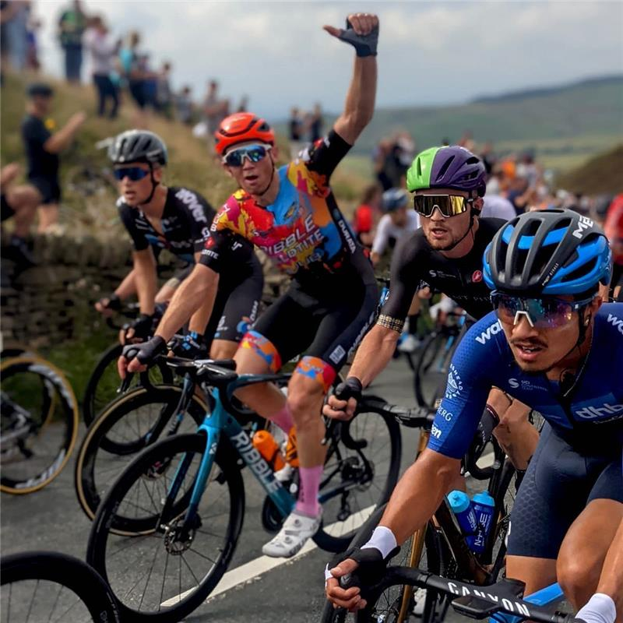
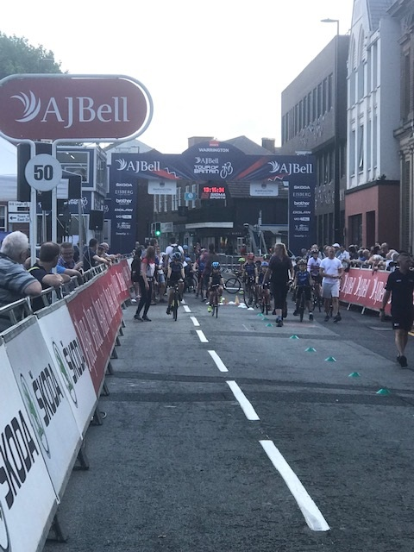
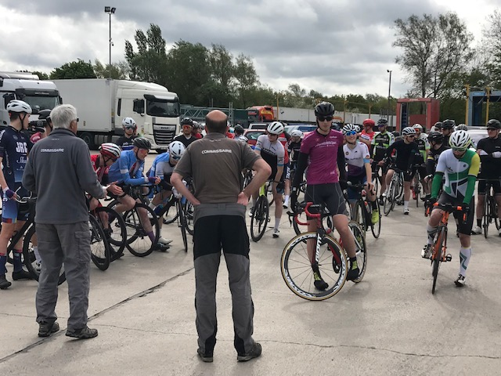
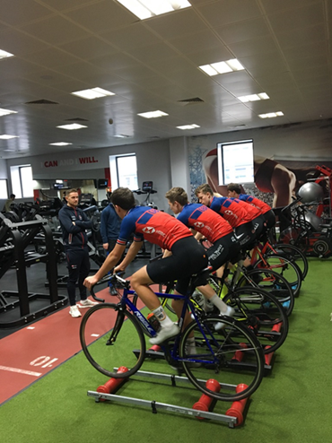
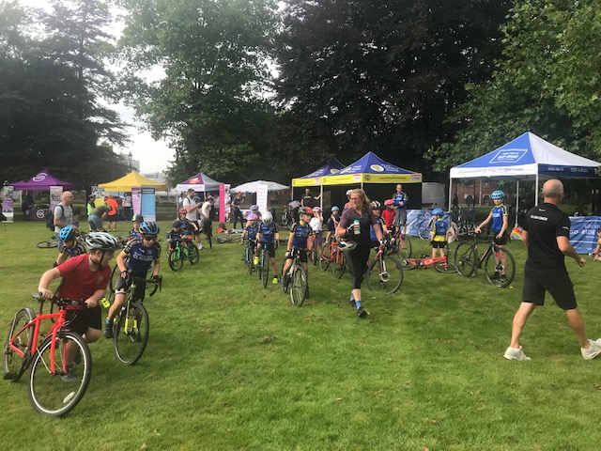
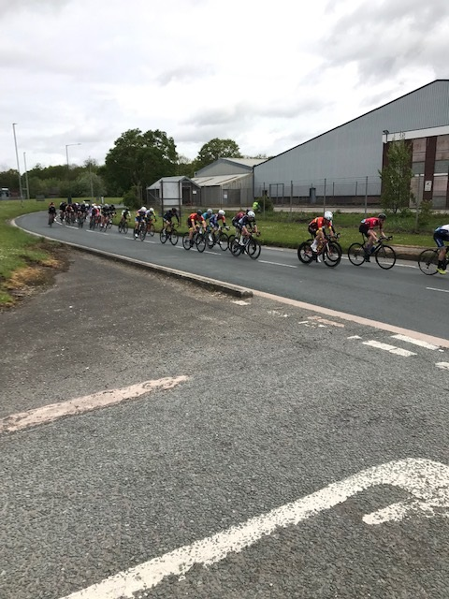
… and some successes in pictures – leading our sport!

Slide 7
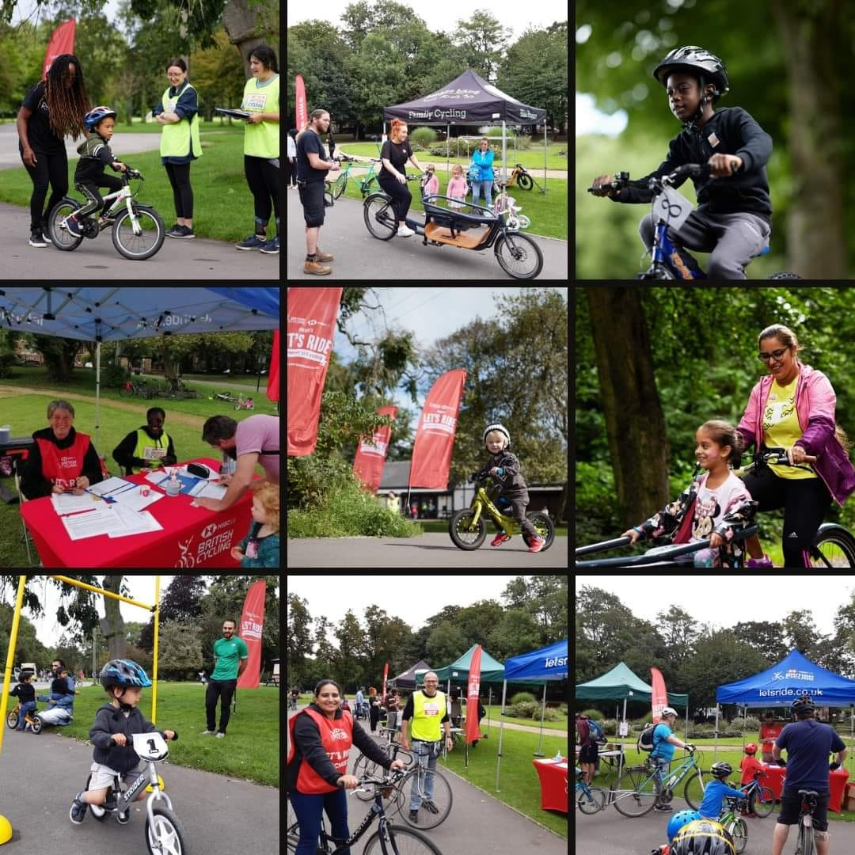
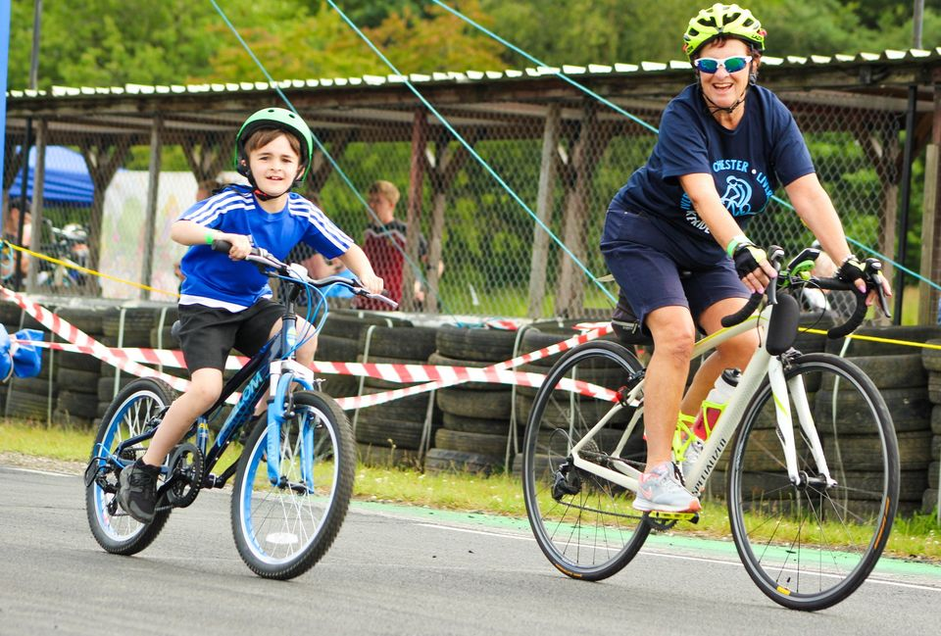
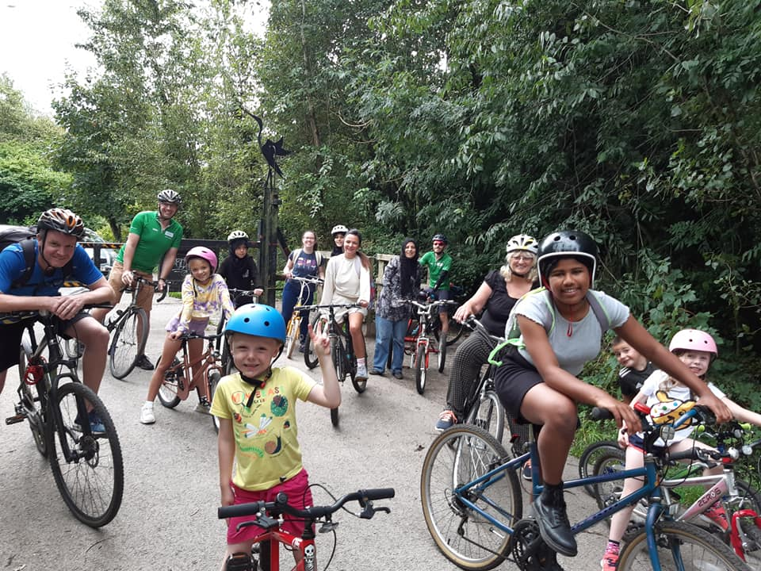
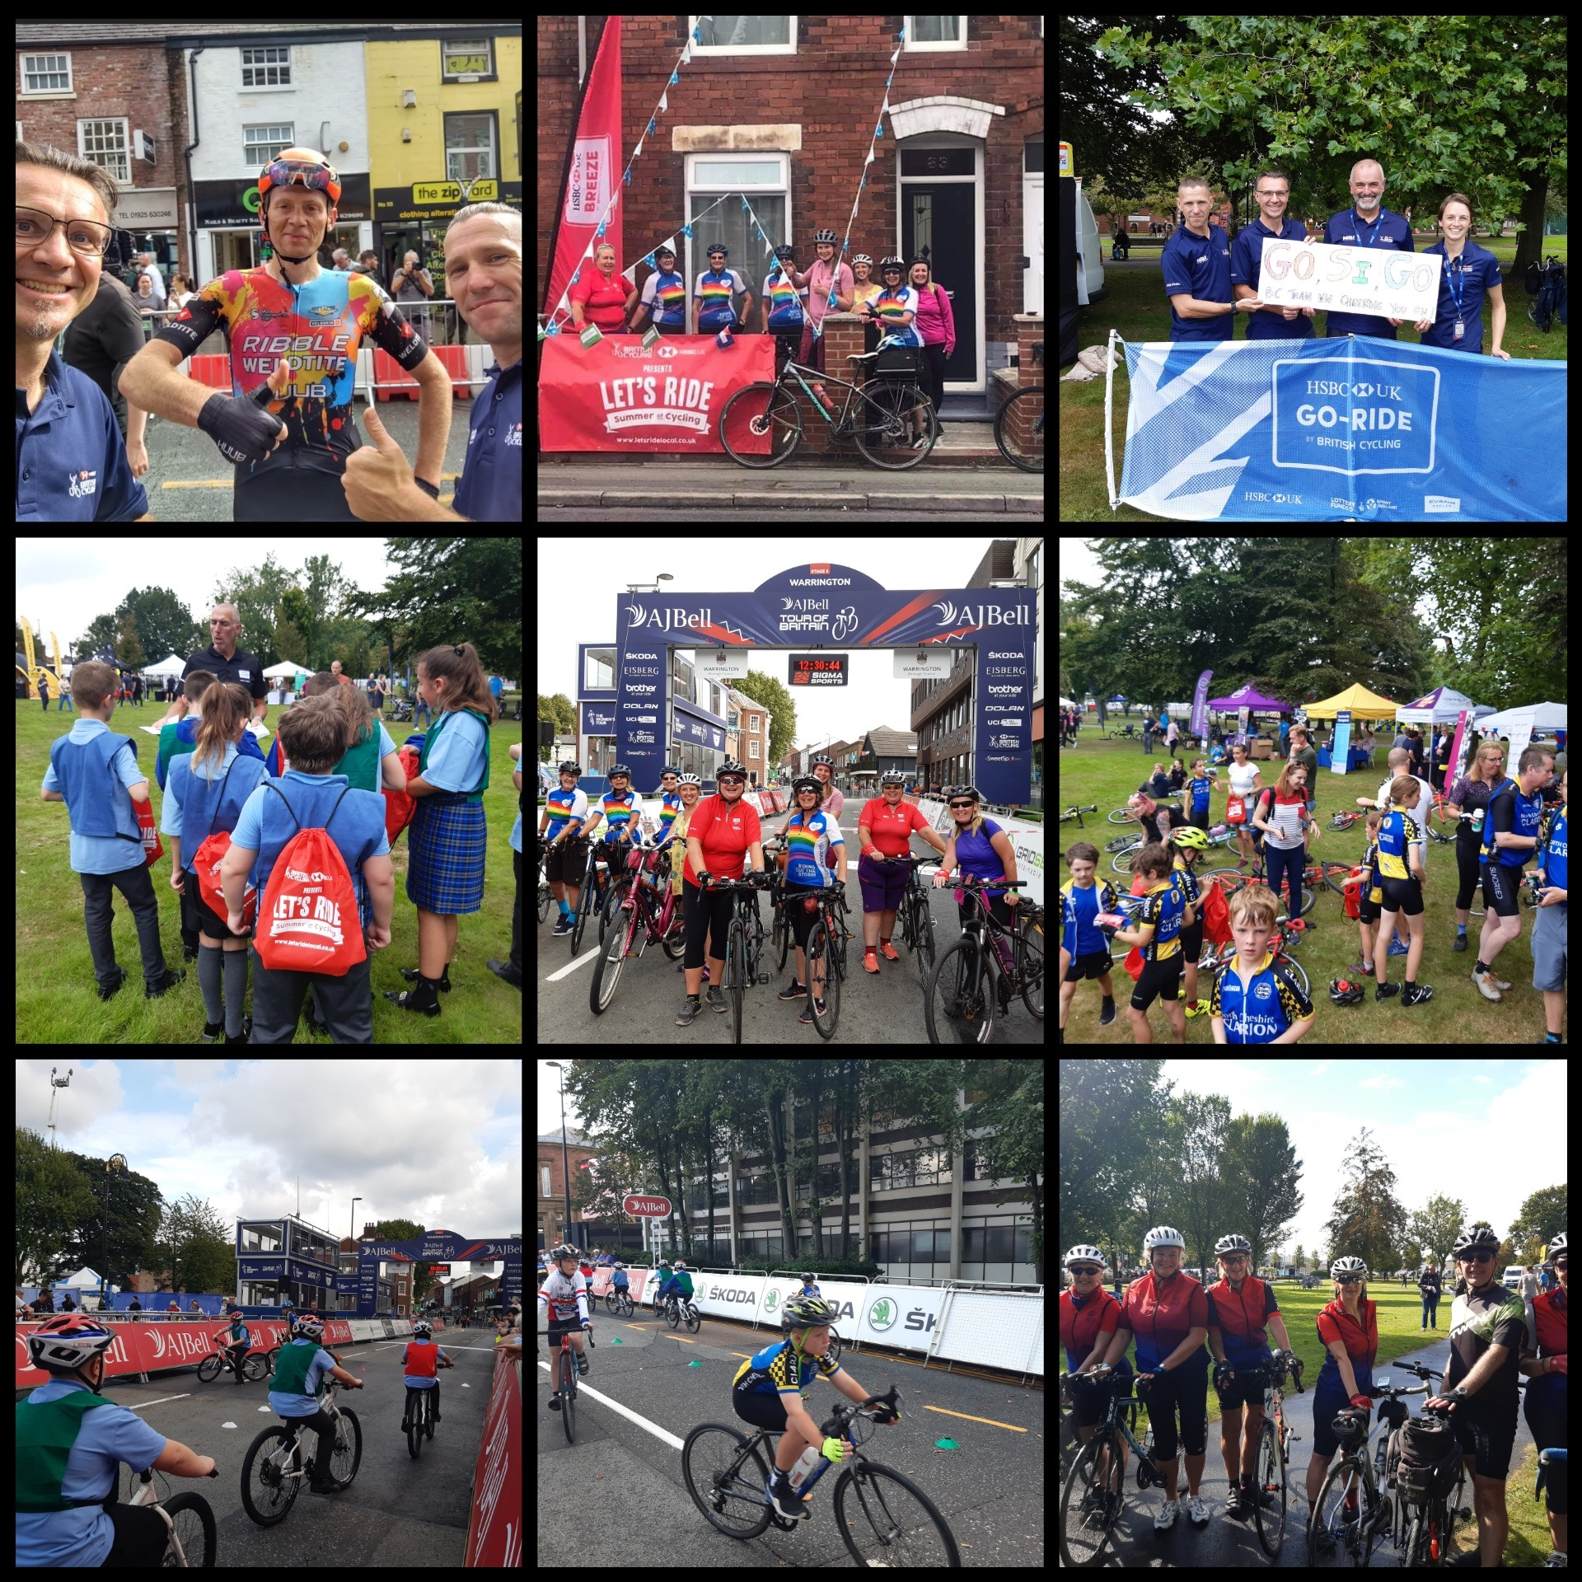
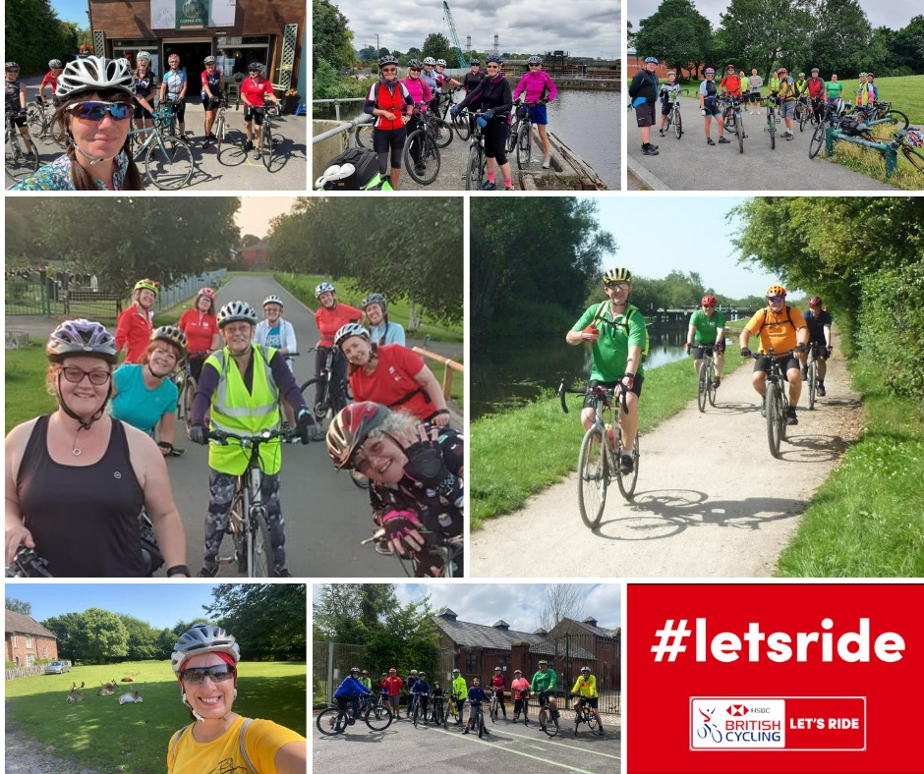
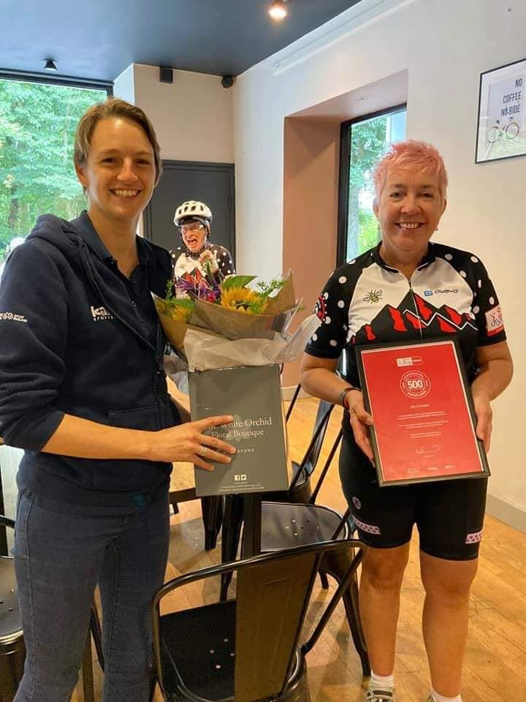
… and some successes in pictures – inspiring communities!

